Slide 1
Succinct and non-interactive zero-knowledge proofs
Yupeng Zhang
Guest lecture, 4/25

Slide 2
Zero-Knowledge Proof (ZKP)
prover
verifier
f(x,w) = y +
secret data:
witness w
Verification: ✓ or ✗
Correctness: Pr[ honest prover and verification is ✓ ] = 1
Soundness: Pr[$y≠f(x,w)$ and verification is ✓ ] ≤ $\frac{1}{2100}$
Zero-knowledge: proof leaks no information about w

Slide 3
Zero-knowledge - Succinct non-interactive knowledge of argument (zk-SNARK)
prover
verifier
f(x,w) = y +
secret data:
witness w
Verification: ✓ or ✗
No interaction between the prover and verifier
Succinctness: proof size is much smaller than the size of w

Slide 4
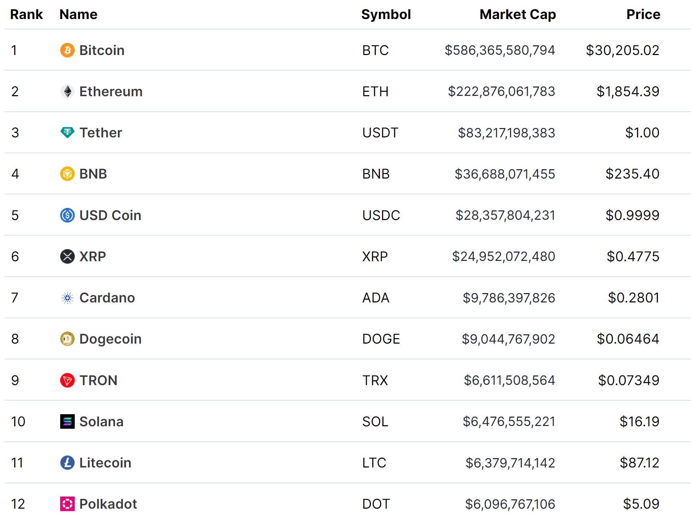
All types of crypto-currencies
26000+ crypto-currencies
https://coinmarketcap.com/

Slide 5
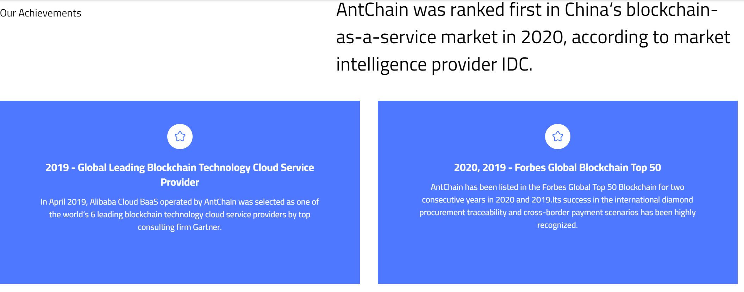
Blockchain Technology

Slide 6
Blockchain and cryptocurrencies
Hash
pointer
Hash
pointer
Hash
pointer
Genesis Block
Block
Block
Block
……
Transaction
Transaction
Transaction
…
Transaction
Transaction
Transaction
…
Transaction
Transaction
Transaction
…
Transaction
Transaction
Transaction
…
Transfer 15 coins from Alice to David_{SIGNED(Alice)}

Slide 7
Security of blockchain
A random party is selected to propose the next block (mining)
Everyone checks that the data of the new block is valid. If yes, append it to the local copy of the blockchain
More than 50% honest parties → consensus without a centralized trusted party

Slide 8
Privacy and scalability problems in blockchain
All data are posted publicly on the chain
https://www.blockchain.com/explorer
Privacy: sender, receiver and amount of TXs
Throughput: Bitcoin: 5 tx/s Ethereum: ~30 tx/s
Visa: ~ 65,000 /s
Notes:
Inherent

Slide 9
Privacy and scalability problems in blockchain
Can we prove data validity without posting the data on chain
Notes:
Inherent

Slide 10
Zero-Knowledge Proof (ZKP)
prover
verifier
f(x,w) = y +
secret data:
witness w
Verification: ✓ or ✗
Correctness: Pr[ honest prover and verification is ✓ ] = 1
Soundness: Pr[$y≠f(x,w)$ and verification is ✓ ] ≤ $\frac{1}{2100}$
Zero-knowledge: proof leaks no information about w
No interaction between the prover and verifier
Succinctness: proof size is much smaller than the size of w

Slide 11
Privacy-preserving Crypto-currencies
Hash
pointer
Block
Hash
pointer
Block
Hash
pointer
Block
……
Transaction
Transaction
Transaction
Transaction
Transaction
Transaction
Transaction
Transaction
Transaction
ZK proof
ZK proof
ZK proof
ZKP for validity of TXs
ZKP for validity of TXs
ZKP for validity of TXs
Soundness → validity of TXs to reach consensus
Zero-knowledge → privacy-preserving TXs

Slide 12
zkRollup
Hash
pointer
Block
Hash
pointer
Block
Hash
pointer
Block
……
ZK proof
ZK proof
ZK proof
ZKP for validity of TXs
ZKP for validity of TXs
ZKP for validity of TXs
Transaction
Transaction
Transaction
Transaction
Transaction
Transaction
Transaction
Transaction
Transaction
Soundness → validity of TXs to reach consensus
Succinctness → batching many TXs into 1 proof

Slide 13
Other applications
zkEVM: Ethereum smart contract
zkBridge: cross-chain transactions
zkML

Slide 14
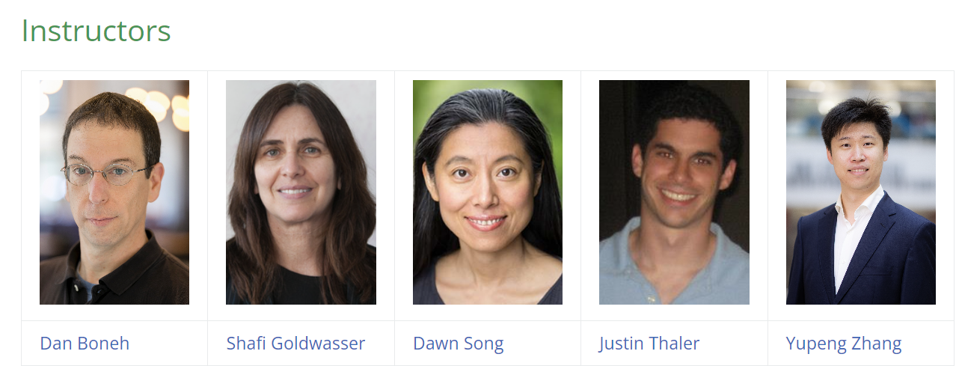
MOOC on Zero-Knowledge Proofs
https://zk-learning.org/

Slide 15
Plan for today
Polynomial commitment
General-purpose zkSNARK: Plonk

Slide 16
What is a polynomial commitment?
Commitment: commit($f$) ⇾com_{f}
prover
verifier
$$u$$
$v$, proof $π$
Verification: ✓ or ✗
f(x)
Correctness: Pr[ honest prover and verification is ✓ ] = 1
Soundness: Pr[$v≠f(u)$ and verification is ✓ ] ≤ $\frac{1}{2100}$
Zero-knowledge: $π$ leaks no information about f(x)
Succinctness: |$π$|<degree of f(x)

Slide 17
Polynomial commitment
keygen($λ$, d) ⇾ gp
commit(gp,$f$) ⇾ com_{f}
eval(gp,$f$,u) ⇾ v, $π$
verify(gp, com_{f} ,u,v, $π$) ⇾ accept or reject

Slide 18
Group
Group: under 1 operation $∘$
Closure: For all a, b in G, the result of the operation, a $∘$ b, is also in G
Associativity: For all a, b and c in G, (a $∘$ b) $∘$ c = a $∘$ (b $∘$ c)
Identity element: There exists an element e in G such that, for every element a in G, the equation e $∘$ a = a $∘$ e = a holds. Such an element is unique
Inverse element: For each a in G, there exists an element b in G, such that a $∘$ b = b $∘$ a = e, where e is the identity element
Commutativity: If for all a,b in G, a $∘$b = b $∘$a, the group is called abelian
Notes:
Example: mod 4

Slide 19
Generator
Theorem: $ℤ_{p}^{∗}$ is a cyclic group, that is
$∃g∈ℤ_{p}^{∗}$ such that $\left\{1,g,g^{2},…,g^{p−2}\right\}=ℤ_{p}^{∗}$
Example $p=7: \left\{1, 3, 32, 33, 34, 35\right\}= \left\{1, 3, 2, 6, 4, 5\right\}=ℤ_{7}^{∗}$
$g$ is called a generator of $ℤ_{p}^{∗}$

Slide 20
Discrete-log assumption:
Discrete-log is hard, exponential time to compute, brute-force
Definition: we say that DLOG is hard in a finite cyclic group $𝔾$ if for all PPT algorithm A,
$$\operatorname{Pr}{[A\left(𝔾,q,g,g^{x}\right)=x]}≤negl(n)$$
where $g$ is a generator, $q$ is the order of the group with $\left|q\right|=n$, and $x∈ℤ_{q}$ is chosen uniformly

Slide 21
Polynomial commitment [KZG10]
$$p,\text{𝔾},g$$
Univariate polynomials${\text{𝓕}= 𝔽}_{p}^{(≤d)}\left[X\right]$
keygen($λ$, d) ⇾ gp:
Sample random secret key $s∈𝔽_{p}$
gp = $\left(g,g^{s},g^{s^{2}}, …,g^{s^{d}}\right)$
Give $s$ to the verifier
Notes:
Kate-Zaverucha-Goldberg’2010

Slide 22
Commitment
$$gp= g,g^{s},g^{s^{2}}, …,g^{s^{d}}$$
prover
verifier
f(x)
Commitment: commit($f$) ⇾com_{f}
$f\left(x\right)=f_{0}+f_{1}x+f_{2}x^{2}+…+f_{d}x^{d}$
com_{f} $=g^{f(s)}$
$=g^{f_{0}+f_{1}s+f_{2}s^{2}+…+f_{d}s^{d}}$
$={\left(g\right)}^{f_{0}}{⋅\left(g^{s}\right)}^{f_{1}}$ ${⋅\left(g^{s^{2}}\right)}^{f_{2}}$ ${⋅…⋅\left(g^{s^{d}}\right)}^{f_{d}}$

Slide 23
Eval
$$gp= g,g^{s},g^{s^{2}}, …,g^{s^{d}}$$
prover
verifier
f(x)
Commitment: commit($f$) ⇾com_{f}
$$u$$
eval(gp,$f$,u) ⇾ v, $π$ :
$f\left(x\right)−f(u)=\left(x−u\right)q(x)$, as $u$ is a root of $f\left(x\right)−f(u)$
Compute $q(x)$ and $π =g^{q(s)}$, using gp

Slide 24
Verify
$$gp= g,g^{s},g^{s^{2}}, …,g^{s^{d}}$$
prover
verifier
f(x)
Commitment: commit($f$) ⇾com_{f}
$$u$$
$$f\left(x\right)−f(u)=\left(x−u\right)q(x)$$
Honest prover: com_{f} $=g^{f(s)}$, $π =g^{q(s)}$, $v =f(u)$
Idea: check the equation at point $s$: $g^{f\left(s\right)−f(u)}=g^{\left(s−u\right)q(s)}$
verify(gp, com_{f} ,u,v, $π$) :$com_{f}/g^{v}=π^{s−u}$

Slide 25
Putting things together
$$gp= g,g^{s},g^{s^{2}}, …,g^{s^{d}}$$
$$s$$
verifier
f(x)
com_{f} $=g^{f(s)}$
$$u$$
$v=f(u)$, proof $π =g^{q(s)}$
Verify:
$$com_{f}/g^{v}=π^{s−u}$$
$$f\left(x\right)−f(u)=\left(x−u\right)q(x)$$

Slide 26
Soundness
q-strong Diffie-Hellman assumption
given $p, g, g^{s}, g^{s^{2}},$ $g^{s^{3}},$ $g^{s^{4}},…,g^{s^{q}}$, cannot compute $c,h$
$s.t. {h=g}^{\frac{1}{s+c}}$

Slide 27
Soundness proof
Proof by contradiction: Suppose $v^{∗}≠f(u)$, $π^{∗}$ passes the verification
${{com_{f}}/{g^{v^{∗}}}={π^{∗}}^{s−u}}^{ }$
$⇔{g^{f\left(s\right)−v^{∗}}={π^{∗}}^{s−u}}^{ }$
${⇔g^{f\left(s\right)−f\left(u\right)+f\left(u\right)−v^{∗}}={π^{∗}}^{s−u}}^{ }$, define $δ=f\left(u\right)−v^{∗}$
$${⇔g^{\left(s−u\right)q(s)+δ}={π^{∗}}^{s−u}}^{ }$$
$${⇔g^{δ}=}^{ }{\left(π^{∗}/g^{q(s)}\right)}^{s−u}$$
$⇔$ $g^{\frac{δ}{s−u}}$ ${= π}^{∗}/g^{q(s)}$
$⇔$ $g^{\frac{1}{s−u}}$ ${=( π}^{∗}/{g^{q\left(s\right)})}^{δ^{−1}}$
breaks q-SDH assumption: given $p, g, g^{s}, g^{s^{2}},$ $g^{s^{3}},$ $g^{s^{4}},…,g^{s^{q}}$, cannot compute $c,h$ $s.t. {h=g}^{\frac{1}{s+c}}$

Slide 28
Complexity
$$gp= g,g^{s},g^{s^{2}}, …,g^{s^{d}}$$
$$s$$
verifier
Commitment: O(1) size and O(d) time
Prover time: O(d)
Proof size: O(1)
Verification: O(1)
com_{f} $=g^{f(s)}$
$$u$$
f(x)
$v=f(u)$, proof $π =g^{q(s)}$
Verify:
$$com_{f}/g^{v}=π^{s−u}$$
$$f\left(x\right)−f(u)=\left(x−u\right)q(x)$$

Slide 29
Public verifiability
$$gp= g,g^{s},g^{s^{2}}, …,g^{s^{d}}$$
$$s$$
verifier
com_{f} $=g^{f(s)}$
$$u$$
f(x)
$v=f(u)$, proof $π =g^{q(s)}$
Verify:
$$com_{f}/g^{v}=π^{s−u}$$
$$f\left(x\right)−f(u)=\left(x−u\right)q(x)$$

Slide 30
Bilinear pairing
($p,𝔾,g, 𝔾_{T},e$)
$𝔾$ and $𝔾_{T}$ are both multiplicative cyclic group of order $p$, $g$ is the generator of 𝔾.
$\text{𝔾}$:base group, ${\text{𝔾}}_{T}$ target group, $e:𝔾×𝔾→𝔾_{T}$
Bilinear: $e\left(P⋅P^{′},Q\right)=e\left(P,Q\right)⋅e(P^{′},Q)$
$e\left(P,Q⋅Q′\right)=e\left(P,Q\right)⋅e(P^{ },Q′)$
Non-degenerate: $g_{T}=e(g,g)$ is a generator of $𝔾_{T}$
Pairing: $e\left(P^{x}, Q^{y}\right)=e{\left(P,Q\right)}^{xy}$
Example: $e\left(g^{x}, g^{y}\right)=e{\left(g,g\right)}^{xy}=e{\left(g^{xy},g\right)}^{ }$

Slide 31
Public verifiability
$$gp= g,g^{s},g^{s^{2}}, …,g^{s^{d}}$$
verifier
com_{f} $=g^{f(s)}$
$$u$$
f(x)
$v=f(u)$, proof $π =g^{q(s)}$
Verify:
$$e(\frac{com_{f}}{g^{v}},g)=e(π,g^{s−u})$$
$$f\left(x\right)−f(u)=\left(x−u\right)q(x)$$

Slide 32
Properties
Keygen: O(d) group exponentiations, delete s!!! Trusted setup
Commit: O(d) group exponentiations, O(1) commitment size
Eval: O(d) group exponentiations
q(x) can be computed efficiently in linear time!
Proof size: O(1), 1 group element
Verifier time: O(1), 1 pairing

Slide 33
Zero-knowledge
Plain KZG is not zero-knowledge
E.g., $com_{f}=g^{f(s)}$ is deterministic
Solution: masking with randomizers
Commit: $com_{f}=g^{f\left(s\right)+rt}$, where s,t are both secrets
Eval: $f\left(x\right)+ry−f\left(u\right)=\left(x−u\right)\left(q\left(x\right)+r^{′}y\right)+y(r−r^{′}(x−u))$
$π_{ }=g^{q_{ }\left(s\right)+r^{′}t}, g^{r−r^{′}(s−u)}$

Slide 34
General-purpose ZKP: Plonk [GWC20]

Slide 35
Computation model: circuits
Arithmetic circuit C(x,w)=y
x
w
prover
verifier
×
+
×
+
secret data:
witness w
×
+
+
×
+
y

Slide 36
Validating the assignment of circuits
a₁
b₁
a₂
b₂
……
Secret
×
+
×
+
a₁
a₂
a₃
…
…
…
…
a_{n}
C,x,w
c₁
c₂
…
…
…
…
b_{n}
b₁
b₂
b₃
prover
×
+
+
c₁
c₂
c₃
…
…
…
…
c_{n}
a_{n-1}
b_{n-1}
a_{n}
b_{n}
×
+
x
y
c_{n-1}
c_{n}
Following the circuit logic

Slide 37
Plonk
polynomial commitment
ZKP for general circuits
Plonk

Slide 38
Plonk [GWC20]
Secret
Public
……
a₁
a₂
a₃
…
…
…
…
a_{n}
L₁
L₂
L₃
…
…
…
…
L_{n}
a₁
b₁
a₂
b₂
×
+
×
+
b₁
b₂
b₃
…
…
…
…
b_{n}
R₁
R₂
R₃
…
…
…
…
R_{n}
c₁
c₂
×
+
+
c₁
c₂
c₃
…
…
…
…
c_{n}
M₁
M₂
M₃
…
…
…
…
M_{n}
×
+
O₁
O₂
O₃
…
…
…
…
O_{n}
Gate relationship:
Mult: $a_{1}×b_{1}=c_{1}$
Add: $a_{2}+b_{2}=c_{2}$
Public input: $b_{1}=3$
Output: $c_{4}=100$
$${L_{i}a}_{i}+R_{i}b_{i}+M_{i}a_{i}×b_{i}+O_{i}c_{i}+Q_{i}=0$$
Example Mult: $L_{1}=0, { R}_{1}=0,M_{1}=1, O_{1}=−1, Q_{1}=0$
Example Add: $L_{2}=1, { R}_{2}=1,M_{2}=0, O_{2}=−1, Q_{2}=0$
prover
Q₁
Q₂
Q₃
…
…
…
…
Q_{n}

Slide 39
Polynomial Representation
……
a₁
a₂
a₃
…
…
…
…
a_{n}
L₁
L₂
L₃
…
…
…
…
L_{n}
a₁
b₁
a₂
b₂
×
+
×
+
b₁
b₂
b₃
…
…
…
…
b_{n}
R₁
R₂
R₃
…
…
…
…
R_{n}
c₁
c₂
×
+
+
c₁
c₂
c₃
…
…
…
…
c_{n}
M₁
M₂
M₃
…
…
…
…
M_{n}
×
+
O₁
O₂
O₃
…
…
…
…
O_{n}
$${L_{i}a}_{i}+R_{i}b_{i}+M_{i}a_{i}×b_{i}+O_{i}c_{i}+Q_{i}=0$$
Q₁
Q₂
Q₃
…
…
…
…
Q_{n}
$L\left(ω^{i}\right)=L_{i}$ for $i=1,2,…,n$
$a\left(ω^{i}\right)=a_{i}$ for $i=1,2,…,n$
$p\left(x\right)=L\left(x\right)a\left(x\right)+R\left(x\right)b\left(x\right)+M\left(x\right)a\left(x\right)b\left(x\right)+O\left(x\right)c\left(x\right)+Q\left(x\right)=0$ for $x=ω^{1},…,ω^{n}$

Slide 40
Root of unity
n-th root of unity $ω^{n}=1 mod p$
$\left\{ω^{1},…,ω^{n}\right\}$ a multiplicative subgroup of size n (power of 2)
Fast Fourier Transform (FFT) / Number Theoretic Transform (NTT)
Coefficients to evaluations in O(n log n)

Slide 41
Polynomial Representation
……
a₁
a₂
a₃
…
…
…
…
a_{n}
L₁
L₂
L₃
…
…
…
…
L_{n}
a₁
b₁
a₂
b₂
×
+
×
+
b₁
b₂
b₃
…
…
…
…
b_{n}
R₁
R₂
R₃
…
…
…
…
R_{n}
c₁
c₂
×
+
+
c₁
c₂
c₃
…
…
…
…
c_{n}
M₁
M₂
M₃
…
…
…
…
M_{n}
×
+
O₁
O₂
O₃
…
…
…
…
O_{n}
$${L_{i}a}_{i}+R_{i}b_{i}+M_{i}a_{i}×b_{i}+O_{i}c_{i}+Q_{i}=0$$
Q₁
Q₂
Q₃
…
…
…
…
Q_{n}
$L\left(ω^{i}\right)=L_{i}$ for $i=1,2,…,n$
$a\left(ω^{i}\right)=a_{i}$ for $i=1,2,…,n$
$p\left(x\right)=L\left(x\right)a\left(x\right)+R\left(x\right)b\left(x\right)+M\left(x\right)a\left(x\right)b\left(x\right)+O\left(x\right)c\left(x\right)+Q\left(x\right)=0$ for $x=ω^{1},…,ω^{n}$
$p\left(x\right)=V\left(x\right)h(x)$ where the vanishing polynomial $V\left(x\right)=\left(x−ω^{1}\right)\left(x−ω^{2}\right)…(x−ω^{n})$

Slide 42
Vanishing polynomial
$$H⊂𝔽, { V}_{H}\left(x\right)=\prod_{a∈H}{(x−a)}$$
For $H=\left\{ω^{1},…,ω^{n}\right\}$, ${ V}_{H}\left(x\right)=x^{n}−1$

Slide 43
Polynomial Representation
……
a₁
a₂
a₃
…
…
…
…
a_{n}
L₁
L₂
L₃
…
…
…
…
L_{n}
a₁
b₁
a₂
b₂
×
+
×
+
b₁
b₂
b₃
…
…
…
…
b_{n}
R₁
R₂
R₃
…
…
…
…
R_{n}
c₁
c₂
×
+
+
c₁
c₂
c₃
…
…
…
…
c_{n}
M₁
M₂
M₃
…
…
…
…
M_{n}
×
+
O₁
O₂
O₃
…
…
…
…
O_{n}
$${L_{i}a}_{i}+R_{i}b_{i}+M_{i}a_{i}×b_{i}+O_{i}c_{i}+Q_{i}=0$$
Q₁
Q₂
Q₃
…
…
…
…
Q_{n}
$L\left(ω^{i}\right)=L_{i}$ for $i=1,2,…,n$
$a\left(ω^{i}\right)=a_{i}$ for $i=1,2,…,n$
$p\left(x\right)=L\left(x\right)a\left(x\right)+R\left(x\right)b\left(x\right)+M\left(x\right)a\left(x\right)b\left(x\right)+O\left(x\right)c\left(x\right)+Q\left(x\right)=0$ for $x=ω^{1},…,ω^{n}$
$p\left(x\right)=V\left(x\right)h(x)$ where the vanishing polynomial $V\left(x\right)=\left(x−ω^{1}\right)\left(x−ω^{2}\right)…(x−ω^{n})$

Slide 44
Polynomial Commitment
commitment of $f(x)$
prover
verifier
evaluation point $r$
$f(r)$ +
$$f(x)$$
Verification: ✓ or ✗

Slide 45
Plonk
a₁
b₁
a₂
b₂
……
×
+
×
+
c₁
c₂
×
+
+
×
+
Commit to $a\left(x\right),b\left(x\right),c\left(x\right),h(x)$
prover
verifier
$$r$$
Open $a\left(r\right),b\left(r\right),c\left(r\right),h(r)$
Verify polynomial commitments
Check $p\left(r\right)=V\left(r\right)h(r)$
Schwartz-Zippel lemma
$$p\left(x\right)=L\left(x\right)a\left(x\right)+R\left(x\right)b\left(x\right)+M\left(x\right)a\left(x\right)b\left(x\right)+O\left(x\right)c\left(x\right)+Q\left(x\right)=V\left(x\right)h(x)$$

Slide 46
Making it non-interactive
Fiat-Shamir heuristic [FS86]
Making public-coin interactive protocols non-interactive
prover
$$m_{1}$$
verifier
prover
verifier
$$m_{1}$$
$$r$$
$$r=H(m_{1})$$
$$m_{2}$$
$$m_{2}$$

Slide 47
Permutation Check
……
a₁
a₂
a₃
…
…
…
…
a_{n}
a₁
b₁
a₂
b₂
×
+
×
+
b₁
b₂
b₃
…
…
…
…
b_{n}
c₁
c₂
×
+
+
×
+
c₁
c₂
c₃
…
…
…
…
c_{n}
Also reduced to polynomial equality checks

Slide 48
Properties
One-time trusted setup (from the polynomial commitment)
O(Clog C) prover time
O(ClogC) field operations in FFT
O(C) group exponentiations in polynomial commitment
O(1) proof size
O(1) verifier time*
$$p\left(x\right)=L\left(x\right)a\left(x\right)+R\left(x\right)b\left(x\right)+M\left(x\right)a\left(x\right)b\left(x\right)+O\left(x\right)c\left(x\right)+Q\left(x\right)=V\left(x\right)h(x)$$

